Slide 1

Focus: How did China’s geographic isolation influence its culture?
Reminders:
Stimulus-Based MC Assessment on Wednesday 10/9. IN CLASS REVIEW 10/8

Slide 2
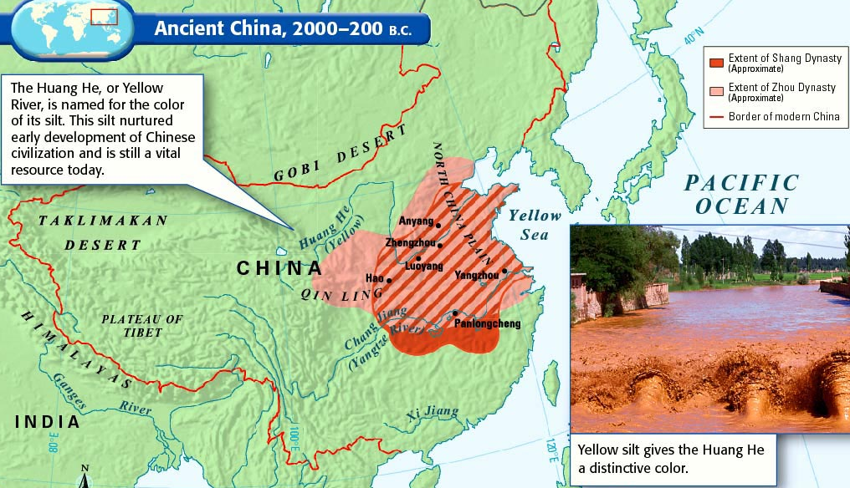
Rivers, Soil and Climate
China’s first River Valley Civilization developed along the two major rivers.
Huang He (yellow river) - flows East from Tibet to Yellow Sea.
Yangzi River/3rd longest river in the world. (Nile 1^{st/} Amazon 2^{nd)}
Early people grew millet, wheat and rice.

Slide 3
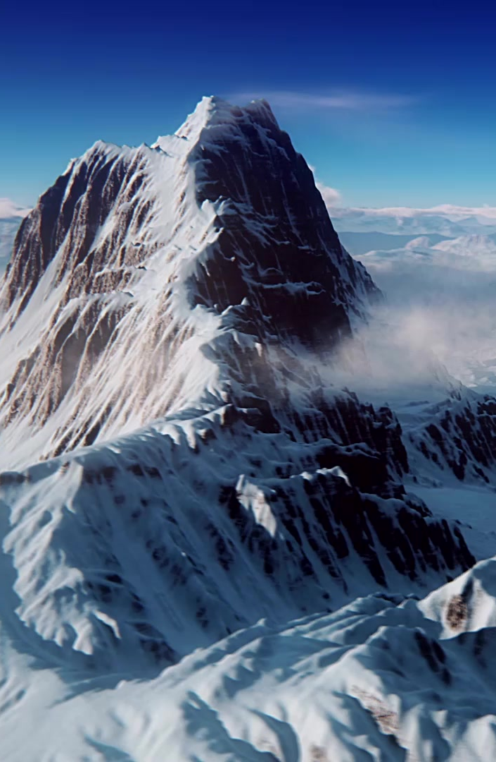
China’s Geography
China’s physical geography is very diverse.
East- Pacific Ocean
North- Gobi Desert
West- Taklamakan Desert
West/South- Himalayan Mountains
How could this be both a benefit and a hindrance to the people of China?
Pair Share: Take a minute to discuss possible answers with your group.

Slide 4

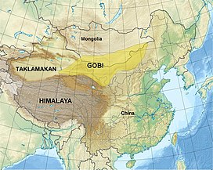

Slide 5
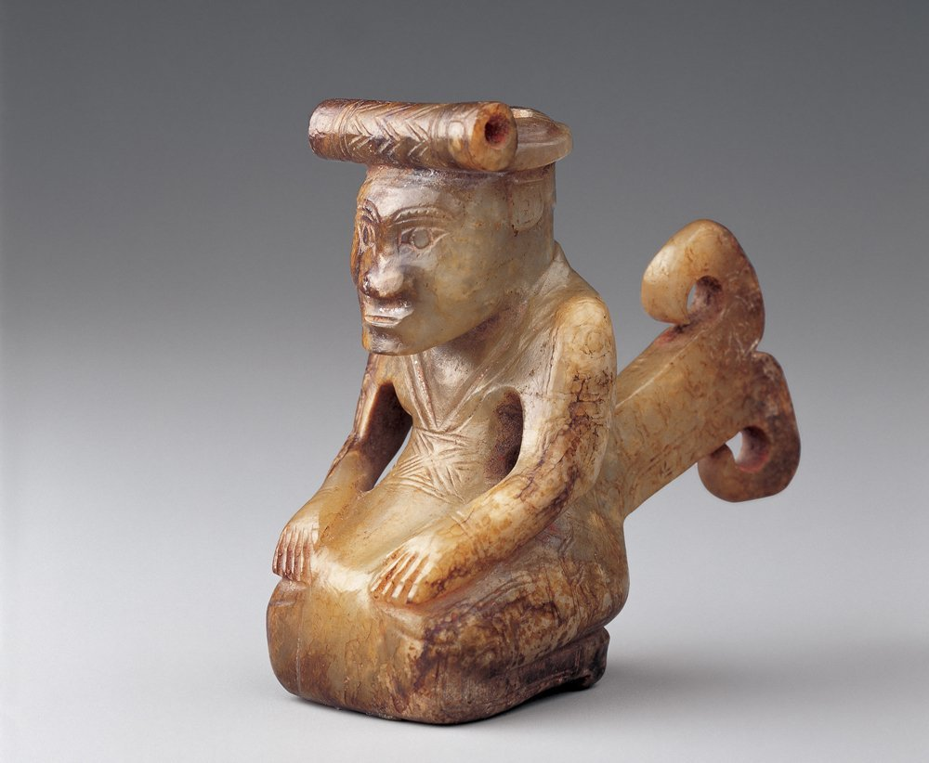
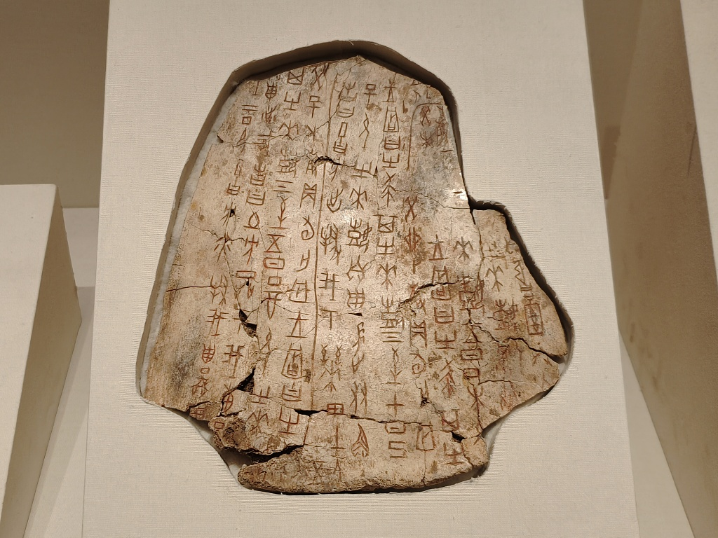
Shang Dynasty (1600-1050 BCE)
Student notes:
Left behind a written record- Shang Characters
Highly ritualistic with signs of animal sacrifice, ancestor worship and divination ceremonies with oracle bones.
Shang society experienced harsh social stratification.
-Noble families owned the land and governed the scattered villages within the Shang lands. They sent tribute or payments to the Shang ruler in exchange for local control.

Slide 6
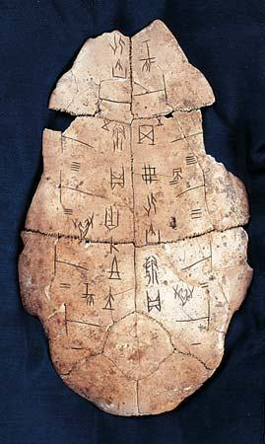
Shang Oracle Bones
Aim: How did China’s geographic isolation influence its culture?
ritual object: diviners would inscribe questions to deities regarding important issues such as:
future weather
harvest fertility
military success
The questions were carved onto the bone or shells using a sharp tool in a language known as oracle bone script. The process of carving used a metal rod put under intense heat and was applied to the bone or shell until it cracked due to thermal expansion.
The pattern of cracks would be interpreted by the diviner for meaning. The oracle bones are important because they bear the earliest form of ancient Chinese writing and contain historically important information. From oracle bones scholars have learned the complete royal genealogy of the Shang dynasty.
Source: http://anthropology.msu.edu/anp363-ss13/2013/03/28/oracle-bones/

Slide 7
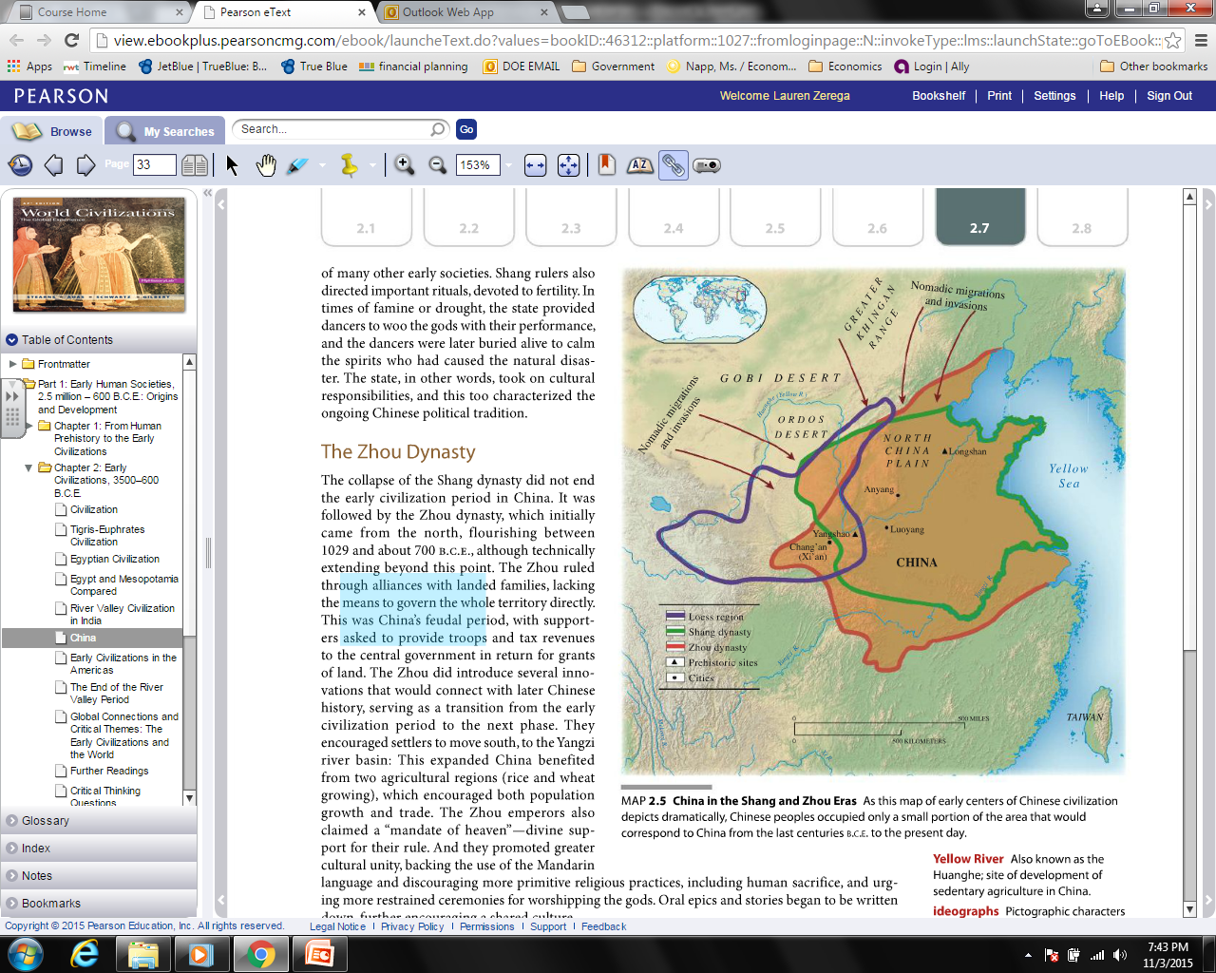
Aim: How did China’s Geographic Isolation Influence its culture?
Middle Kingdom: or Middle Country, dates from c.1000 B.C., when it was ruled by the Zhou empire situated on the North China Plain. The Zhou people, unaware of high civilizations in the West, believed their empire occupied the middle of the earth, surrounded by barbarians.
Ethnocentrism: the belief of superiority in one's personal ethnic group, but it can also develop from racial or religious differences. Belief that you are better than other individuals for reasons based on heritage.

Slide 8
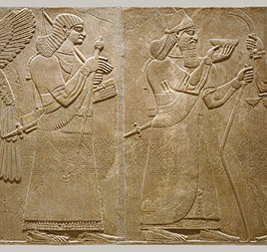
Excerpt from the relief of King Ashurnasirpal II of Assyria, translated from cuneiform. (883 to 859 BCE)
“Palace of Ashurnasirpal, priest of Ashur, favorite of Enlil and Ninurta, beloved of Anu and Dagan, the weapon of the great gods, the mighty king, king of the world, king of Assyria; son of Tukulti-Ninurta, the great king, the mighty king, king of Assyria, the son of Adad-nirari, the great king, the mighty king of Assyria… the wonderful shepherd who is not afraid of battle; the great flood which none can oppose; the king who makes those who are not subject to him submissive; who has subjugated all mankind; the mighty warrior who treads on the neck of his enemies, tramples down all foes, and shatters the forces of the proud; the king who acts with the support of the great gods, and whose hand has conquered all lands, who has subjugated all the mountains and received their tribute, taking hostages and establishing his power over all countries.”

Slide 9
Stimulus Based Multiple Choice Practice
1. Which of the following best explains the significance of Ashurnasirpal II's title "king of the world"?
A) It reflects the economic prosperity of the Assyrian Empire.
B) It illustrates the divine right of kings and the political ideology of imperial authority.
C) It indicates his role as a cultural leader within the empire.
D) It shows his commitment to trade and diplomacy with neighboring states.
2. The phrase "the mighty warrior who treads on the neck of his enemies" can best be interpreted as a reflection of:
A) The importance of mercy and diplomacy in Assyrian governance.
B) The militaristic culture and expansionist policies of the Assyrian Empire.
C) The development of a legal system that promoted peace.
D) The emphasis on agricultural development over military conquests.
3. According to the excerpt which of the following factors contributed most significantly to the power of kings like Ashurnasirpal II in ancient Mesopotamia?
A) The establishment of trade routes across the region.
B) The ability to harness and control agricultural surpluses.
C) The support of powerful deities as indicated in royal propaganda.
D) The integration of diverse cultures within the empire.

Slide 10
4. The excerpt reflects the Assyrian practice of using propaganda to:
A) Encourage artistic expression and cultural achievements.
B) Justify military conquests and the divine right to rule.
C) Promote economic stability and trade.
D) Foster alliances with neighboring states.
5. In the context of ancient Near Eastern societies, the depiction of kings as "weapons of the great gods" suggests that:
A) Religious beliefs were integral to political authority.
B) Kings operated independently from religious institutions.
C) Warfare was viewed as a purely economic activity.
D) The role of women was crucial in maintaining religious practices.
6. What does the reference to "taking hostages and establishing power over all countries" indicate about the Assyrian approach to governance?
A) A focus on peaceful negotiations to resolve conflicts.
B) A reliance on military strength and coercion to maintain control.
C) An emphasis on cultural assimilation of conquered peoples.
D) A strategy to promote economic cooperation and trade.

Slide 11
Question #1
Which characteristic did the early civilizations that developed along the Nile, the Tigris-Euphrates and the Huang He (Yellow River) have in common?
A) each society’s religious beliefs were based on monotheism
B) urban communities were built using stone tools
C) the form of government in each community was based on male suffrage
D) transportation and communication were promoted by a mild climate, fertile soil, and natural waterways

Slide 12
Question #2
Aim: How did China’s Geographic Isolation Influence its culture?
The Chinese historically called their land the “Middle Kingdom.” Colonial Europeans in the 1800’s often used the term “backward” to refer to China. These statements best illustrate
A. the failure of geographers to establish a universal terminology
B. the importance of East Asia in world history
C. the adoption of policies of nonalignment
D. attitudes of ethnocentrism in both cultures

